Slide 1
SCIM Use Cases

Slide 2






SCIM Basics
tel:+1-201-555-0123
/Users
Standardized
in RFC7643
user
janesmith
/Groups
group
New Draft Extension
/device
device
Resource Type
Resource Object(RO)
Resource Attribute (RA)
Definition of a resource name, endpoint URL, schema, and other metadata that indicate where a resource is managed and how it is composed
Set of attributes for a specific resource
A name-value pair containing at least one simple or complex value, either of which may be multi-valued.

Slide 3

Orchestrator Roles
Resource Creator (RC)
Resource Updater (RU)
Resource Manager (RM)
Resource Subscriber (RS)
Component of the system that create/updates the resources and their attributes
Component of the system that manage multiple Creators and Subscribers, maintaining the latest information on the resources
Component of the system that will consume the information from Resource Manager

Slide 4
Provisioning Domains & SCIM Actions/Triggers
SCIM Client
SCIM Server
/Object
RC/RU
(resource creator/updater)
RS
Resource Subscriber
Active Push
Implementer’s Provisioning Domain

Slide 5
Provisioning Domains & Triggers
SCIM Server
SCIM Client
/Object
RC/RU
(resource creator/updater)
RS
Resource Subscriber
Active/Delta Pull
Which Implementer are you?

Slide 6
Use Cases
Common Generic Scenarios

Slide 7
UC1: Resource Subscriber Single-tenant Resource Subscriber (RS)
Implementer’s
Provisioning Domain
Resource Subscriber (RS)
Resource Subscribers (RS) receive data from a remote corporate data store
RS can be a SCIM Server or Client
Implementer Considerations
Matching conventions with existing API infrastructure
Cursor vs. Index pagination
Using existing API security
Least Privilege/authorization
Option 1 it is almost 100% of the implementations today
Option 2 is a good option for when the Resource Subscriber is not reached from remote corporate data store
SCIM Server
SCIM Client
Source X
Active Push
Consumer X
Option 1
/Object
SCIM Client
SCIM Server
Option 2
Source X
Active/Delta Pull
Consumer X
/Object

Slide 8
UC1: Resource Subscriber Multi-tenant Resource Subscriber (RS)
Implementer’s
Provisioning Domain
Resource Subscriber (RS)
Resource Subscribers (RS) receive data from a remote corporate data store
RS can be a SCIM Server or Client
Implementer Considerations
Matching conventions with existing API infrastructure
Cursor vs. Index pagination
Using existing API security
Least Privilege/authorization
SCIM Server
SCIM Client
Source A
Active Push
Tenant A
/Object
SCIM Client
Option 1
Source B
Active Push
Tenant B
Implementer’s
Provisioning Domain
/Object
SCIM Client
Resource Subscriber (RS)
Source C
Active Push
Tenant C
SCIM Client
SCIM Server
/Object
Source A
Active/Delta Pull
Tenant A
/Object
SCIM Server
Option 1 it is almost 100% of the implementations today
Option 2 is a good option for when the Resource Subscriber is not reached from remote corporate data store
Option 2
Source B
Active/Delta Pull
Tenant B
/Object
SCIM Server
Source C
Active/Delta Pull
Tenant C
/Object

Slide 9
UC2: Resource Creator Single-tenant Resource Creator/Updater (RC/RU)
Implementer’s
Provisioning Domain
Single-Tenant Resource Creator/Updater (RC/RU) sends data to consumer
RC/RU can be a Single-Tenant SCIM Server or Client
Implementer Considerations
Matching conventions with existing API infrastructure
Cursor vs. Index pagination
Using existing API security
Least Privilege/authorization
Option 1 it a common implementation today
Option 2 is a good option for when the Resource Subscriber is not reached from remote corporate data store
Resource Creator/
Updater (RC/RU)
SCIM Client
SCIM Server
Option 1
Source X
Active Push
Consumer X
/Object
SCIM Server
SCIM Client
Option 2
Source X
Active/Delta Pull
Consumer X
/Object

Slide 10
UC2: Resource Creator Multi-tenant Resource Creator/Updater (RC/RU)
Implementer’s
Provisioning Domain
Multi-Tenant Resource Creator/Updater (RC/RU) sends data to consumers
RC/RU can be a Multi-Tenant SCIM Server or Client
Implementer Considerations
Matching conventions with existing API infrastructure
Cursor vs. Index pagination
Using existing API security
Least Privilege/authorization
Resource Creator/Updater (RC/RU)
SCIM Client
SCIM Server
Tenant A
Active Push
Consumer A
/Object
SCIM Server
Option 1
Tenant B
Active Push
Consumer B
/Object
Implementer’s
Provisioning Domain
SCIM Server
Resource Creator/Updater (RC/RU)
Tenant C
Active Push
Consumer C
SCIM Server
SCIM Client
/Object
Tenant A
Active/Delta Pull
Consumer A
/Object
Option 1 it is almost 100% of the implementations today
Option 2 is a good option for when the Resource Subscriber is not reached from remote corporate data store
SCIM Client
Option 2
Tenant B
Active/Delta Pull
Consumer B
/Object
SCIM Client
Tenant C
Active/Delta Pull
Consumer C
/Object

Slide 11
UC3: Resource Manager Single-Tenant Resource Manager (RM)
Implementer’s Provisioning Domain
UpStream
Resource Manager (RM)
DownStream
Source A
Non-SCIM
Consumer A,B
Source Z
SCIM Server
Normally one or more upstream object database that populates the Resource Manager that after provides that resource information to downstream services that requires a specific that requires a specific sets of the populated objects.
Implementer Considerations
Matching conventions with existing API infrastructure
Cursor vs. Index pagination
Using existing API security
Least Privilege/authorization
Option 1 and 2 are most common to see in the Implementers Provision Domain
Option 3 and 4 will make sense when upstream or downstream services can’t be directly reach.
Option 1
Active Push
Active Push
Consumer Z
Source B
/Object
SCIM
Client
/Object
SCIM Client
SCIM Server
Source A
Non-SCIM
Consumer A,B
Source Z
SCIM Server
Option 2
Active Push
Consumer Z
Source B
Active/Delta Pull
/Object
/Object
SCIM
Client
SCIM
Client
SCIM Server
Source A
Non-SCIM
Consumer A,B
Source Z
SCIM Client
Option 3
Active Push
Active/Delta Pull
Consumer Z
Source B
/Object
/Object
SCIM Client
SCIM Server
SCIM Server
Source A
Non-SCIM
Consumer A,B
Source Z
SCIM Client
Option4
Active/Delta Pull
Consumer Z
Source B
Active/Delta Pull
/Object
SCIM
Client
/Object
SCIM Server
SCIM Server

Slide 12
UC3: Resource Manager Multi-tenant Resource Manager (RM)
Implementer’s Provisioning Domain
UpStream
Resource Manager (RM)
DownStream
Tenant 1
REST API
SCIM Client
Source A
Non-SCIM
Consumer A
Normally one or more upstream object database that populates the Multi-Tenant Resource Manager, that after provides that resource information to downstream services that requires a specific sets of the populated objects.
Implementer Considerations
Matching conventions with existing API infrastructure
Cursor vs. Index pagination
Using existing API security
Least Privilege/authorization
Typically, we see SCIM Clients functions in the Resource Manager.
To address issues of upstream or downstream services not be reachable we might also fin in the Resources Manager the SCIM server role.
Homegrown
Active Push
SCIM Server
/Object
Tenant 2
SCIM Client
SCIM Client
Source B
Consumer B
SCIM Server
Active/Delta Pull
Active Push
SCIM Server
/Object
/Object
Tenant 2
SCIM Server
SCIM Server
Source B
Consumer B
SCIM Client
Active Push
Active/Delta Pull
SCIM Client
/Object
/Object
/Object
/Object
Tenant 3
SCIM Server
SCIM Client
Consumer C
Source C
SCIM Client
Active Push
Active Push
SCIM Server
/Object
/Object
Tenant 4
SCIM Client
SCIM Server
Consumer D
Source D
Active/Delta Pull
SCIM Client
SCIM Server
Active/Delta Pull
/Object
/Object

Slide 13
Use Cases
Specific implementations

Slide 14
UC4: Partner Device Registry Manufacturer details pushed to customers at time of device sale
Implementer’s
Provisioning Domain
Customer A
SCIM Client
SCIM Server
Specification:
ROs representing devices purchased by a customer are pushed only to that customer
Maybe or may not be Multi-tenant
Option 1
active push
Customer B
SCIM Client
active push
SCIM Server
Option 1
Customer C
SCIM Server
Active pull
SCIM Client
Option 2
Manufacturer

Slide 15
UC5: Device identity Creation from Commissioner Tool Customer uses Client App to provide specific centric customer attributes of the IOT device
Specification:
IOT devices using Matter or other protocol provide the Client App (Mobile App, Web Application) information about itself
Client App fill up information about the IOT device
Typically, the communication between IOT Device and Client App is using protocols like Bluetooth, Zigbee, Thread, etc.
SCIM clients should only be able to access to devices that they manage
Commissioner tool
Client App
Device Manager
SCIM Server
active push
SCIM Client
Non SCIM
Client App +
Commissioner Tool
active push
SCIM Client

Slide 16
UC6: Client App get directory services Client App gets information about all the devices and its attributes in customer environment
Specification:
Client App gets from device manager information about all devices and its attributes from their environments
Client App does the operation of downloading the full list of devices typically every day in non working hours, optionally with on-demand sync
SCIM clients should only be able to access to devices that they manage
Commissioner tool
Client App
Device Manager
active pull
SCIM Client
Non SCIM
SCIM Server
active pull
SCIM Client

Slide 17
UC7: other device use cases Provide credentials to manage device
Specification:
Device manager provides certificate and application details to the Devices gateway to allow it to establish trust.
Implementer’s
Provisioning Domain
Commissioner tool
Client App
Device Manager
active push
SCIM Server
Non SCIM
SCIM Client

Slide 18
UC8: Enterprise Simple Apps Single-tenant Resource Creators & Subscribers
Implementer’s Provisioning Domain
Some apps can’t run fancy SCIM implementations
Homegrown apps with local databases
Small line of business applications
If no native provisioning capabilities
HTTP Headers
Libraries / framework modules
Proxies
No ability to be SCIM Server
Often must be client
In-Domain Provisioning Tool
Non-SCIM
(Direct database update)
Local App A (SQL-based)
SCIM Server
SCIM Active Pull
Local App B
(SCIM Client)
Local App C
(Proprietary API/library)
Non-SCIM
(Proprietary connector)

Slide 19
UC9: RA authority in SaaS App Creation and Updating of attributes resides in SaaS App and Resource Creators/Updaters
Option 1
Implementer’s
Provisioning Domain
Customer A
SCIM Client
SCIM Server
Some Attributes are own by the SaaS Application while the Resource Object and the other attributes are own by the IdM
active push
SCIM Server
active push
SCIM Client
Option 2
Implementer’s
Provisioning Domain
Customer A
SCIM Client
active push
SCIM Server
active/delta pull

Slide 20
UC10: Reconciliation Bringing consistency between the IdM and the Enterprise Applications
Because of inconsistencies or mistakes in the SaaS App Resource Objects and it attributes might change and there is no visibility of the IdM that it happens.
System will do reconciliation to make sure that Resource Objects and its Attributes are consistent across different systems
If there is a new attributes from SCIM Server in the Delta Pull, the SCIM client will do a push to fix it and make again synchronize
Implementer’s
Provisioning Domain
Customer B
1
3
SCIM Client
active push
SCIM Server
active/delta pull
2

Slide 21
UC11: HR Application
Option 1
Implementer’s
Provisioning Domain
Customer A
SCIM Client
SCIM Server
Some Attributes are own by the SaaS Application while the Resource Object and the other attributes are own by the Provision domain (Typically the IdP)
active push
SCIM Server
active push
SCIM Client
Option 2
Implementer’s
Provisioning Domain
Customer B
SCIM Client
active push
SCIM Server
active/delta pull

Slide 22
Extra

Slide 23
UC3: Multi-tenant IAM Provisioning Platform Multi-tenant Resource Manager
Implementer’s Provisioning Domain
HR System X
(customer A)
REST API
SCIM Client
SaaS App J
Multiple situations and requirements
Resource objects and attributes can be transformed between actions
Non-SCIM
active push
SCIM
Server
Homegrown
SCIM Client
SCIM Client
SaaS App J
(customer B)
HR System Y
SCIM Server
active pull
active push
SCIM Server
HR System X
(customer C)
SCIM Server
SCIM Client
IAM Platform P
active push
SCIM Server C
SCIM Client
active push
delta pull

Slide 24
Trigger : Events

Slide 25
UC5: SCIM Events Combined actions/triggers
Provisioning Domain A
Provisioning Domain B
SCIM data can be aggregated, sorted, routed
Uses SSF pub/sub mechanism instead of REST
SCIM Server A
SCIM Entity X
SCIM Actions
SCIM Actions
Shared
Signals
Framework
Transmitter
Shared
Signals
Framework
Receiver
SCIM Server B
SCIM Entity Y
SCIM Actions
SCIM Actions
SCIM Server C
SCIM Entity Z

Slide 26
Event with Domain Replication Mode
SCIM
Server B
State E1
State E2
State E3
Event Operation
Event Operation
Event Operation
Domain Replication Mode
Domain Replication Mode
Domain Replication Mode
Event Operation
Domain Replication Mode
SCIM
Server A
State B1
State B2
State B4
SCIM Operation
SCIM
Client Z
DQ Token
State B1
State B2
State B3
State B4
Client-side
Change
TTS
(time to sync)
TTS
TTS
TTS
Client-side
Reconciliation
Deltas in
change Database

Slide 27
Event with Co-Ordinated Provision
SCIM
Server B
State E1
State E2
State E3
Event Operation
Event Operation
Event Operation
Co-Ordinated Provision
SCIM GET
Co-Ordinated Provision
SCIM GET
Co-Ordinated Provision
SCIM GET
Co-Ordinated Provision
SCIM GET
SCIM
Server A
State B1
State B2
State B4
SCIM Operation
SCIM Operation
SCIM Operation
SCIM Operation
SCIM
Client Z
DQ Token
State B1
State B2
State B3
State B4
Client-side
Change
TTS
(time to sync)
TTS
TTS
TTS
Client-side
Reconciliation
Deltas in
change Database

Slide 28
Other Slides

Slide 29
Summary: SCIM use cases document
Planned to obsolete RFC 7642
Places single SCIM actions & triggers into larger context
Use cases include historical uses and new extensions

Slide 30
SCIM Basics
SCIM Server
(aka Service Provider)
State 1
State 2
State 3
Highly available REST API endpoint
Manages many ROs
Open to one/more REST clients
Time

Slide 31
SCIM Basics
SCIM Server
(aka Service Provider)
State 1
State 2
State 3
Active software
Calls endpoints using HTTP verbs (GET, PUSH, DELETE)
Must be credentialled by SCIM Server
SCIM Client
State X
State Y
State Z
Time

Slide 32
SCIM Basics
SCIM Server
(aka Service Provider)
State 1
State 2
State 3
Actions (what): push, pull, delta pull
Triggers (when): time, app changes, event
SCIM Client
State X
State Y
State Z
Time

Slide 33
Actions & Triggers

Slide 34
Time-based Active Push
Ro/RA change is moved from client to server on a periodic basis
SCIM Server
State B1
State B2
State B4
active
push
active
push
active
push
active
push
Trigger
SCIM Client
State B1
State B2
State B3
State B4
TTS
(time to sync)
TTS
TTS
TTS

Slide 35
Time-based Active Pull
Ro/RA change is moved from server to client on a periodic basis
SCIM Server
State A1
State A2
State A3
active
pull
active
pull
active
pull
active
pull
Trigger
SCIM Client
State A1
State A2
State A3
TTS
(time to sync)
TTS
TTS
TTS

Slide 36
Time-based Active Delta Pull
A1
A2
A4
SCIM Server
State A1
State A2
State A3
State A4
DQ Token
(initial)
active
pull
delta
active
pull
delta
active
pull
delta
active
pull
A1
A2
A4
Trigger
SCIM Client
State B1
State A2
State A4
TTS
(time to sync)
TTS
TTS
TTS

Slide 37
Trigger : Application
Application triggers occur when administrative or end-user interfaces are manipulated.

Slide 38
Application Active Push
The most common deployments today
SCIM
Server A
State B1
State B2
State B3
State B4
active
push
active
push
active
push
SCIM
Client B
State B1
State B2
State B3
State B4
Client-side
Change
TTS
TTS
TTS

Slide 39
Application Active Pull
SCIM
Server A
State A1
State A2
State A3
some
trigger
active
pull
some
trigger
active
pull
SCIM
Client B
State A1
State A2
State A3
Client-side
Change
TTS
(time to sync)
TTS

Slide 40
Application Delta Pull
SCIM
Server A
A1
A2
A3
State A1
State A2
State A3
some
trigger
initial
active
pull
some
trigger
A1
Delta
active
pull
some
trigger
Delta
active
pull
A2
SCIM
Client B
DQ Token
State A1
State A2
State A3
Client-side
Change
TTS
(time to sync)
TTS
(time to sync)
TTS

Slide 41
Trigger : SSO

Slide 42
Triggered Single Sign-On
Single User Flow
SCIM
Server A
State A1
State A2
State A3
SCIM
Push
User
additional
Details
SCIM
Push
User
additional
Details
SCIM
Push
User
additional
Details
First Time SSO with User creation
SSO
With user
details
SSO
With user
details
SCIM
Client B
DQ Token
State A1
State A2
State A3
Client-side
Change
TTS
(time to sync)
TTS
(time to sync)
TTS
(time to sync)
Client-side
Reconciliation
Deltas in
change Database

Slide 43
Use Cases

Slide 44
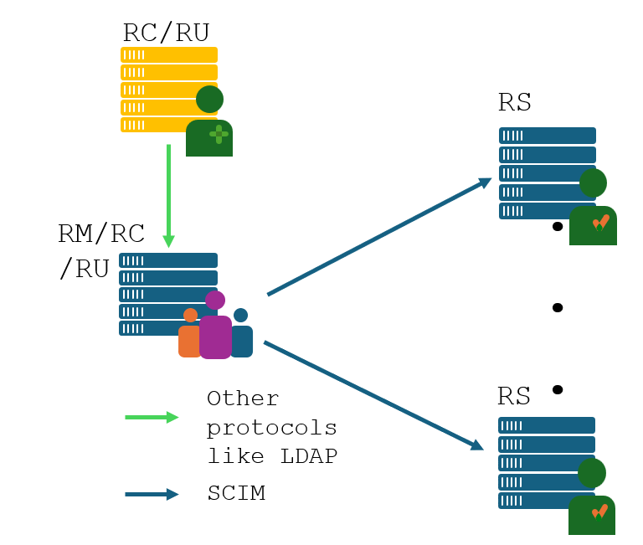
SCIM Use Case 2
IdM doing CRUD operations on SaaS applications, and Objects coming from external non SCIM source
SaaS App
SCIM Server
State B1
State B2
State B4
active
push
active
push
active
push
active
push
IDM
SCIM Client
State B1
State B2
State B3
State B4
DQ Token
Non SCIM
update
Non SCIM
update
Non SCIM
update
Client-side
Change
Legacy IdM
State T1
State T2
State T3
Client-side
Reconciliation
TTS
(time to sync)
TTS
TTS
TTS
Deltas in
change Database

Slide 45
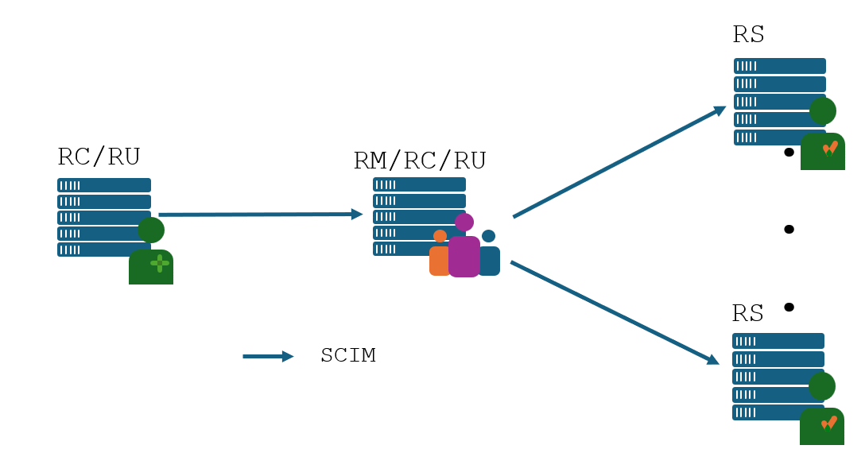
SCIM Use Cases 3.1
IdM doing CRUD operations on SaaS applications, and Objects coming from external SCIM source
SaaS App
SCIM Server
State B1
State B2
State B4
active
push
active
push
active
push
active
push
IDaaS
SCIM Client
SCIM Server
State B1
State B2
State B3
State B4
DQ Token
active
push
active
push
active
push
Client-side
Change
HR App
SCIM Client
State H1
State H2
State H3
Client-side
Reconciliation
TTS
(time to sync)
TTS
TTS
TTS
Deltas in
change Database

Slide 46
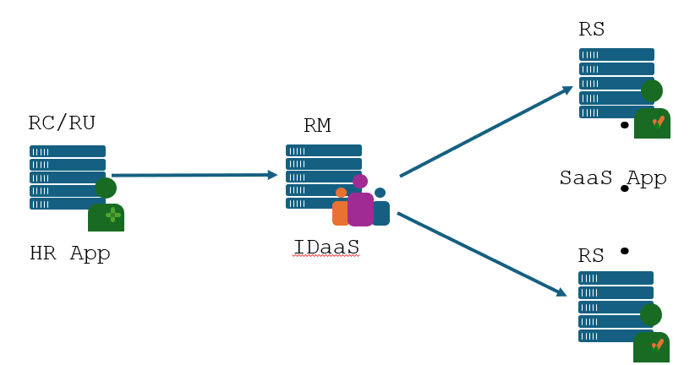
SCIM Use Cases 3.2
IdM doing CRUD operations on SaaS applications, and Objects coming from external SCIM source
SaaS App
SCIM Server
State B1
State B2
State B3
State B4
active
push
active
push
active
push
active
push
IDaaS
SCIM Client
State B1
State B2
State B3
State B4
DQ Token
Initial
active
pull
Client-side
Change
active
pull
active
pull
HR App
SCIM Server
State H1
State H2
State H3
Client-side
Reconciliation
TTS
(time to sync)
TTS
TTS
TTS
Deltas in
change Database

